Slide 1
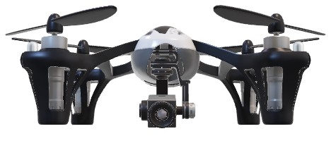
Milestone I Presentation
FPGA for Machine Learning on a Drone

Slide 2
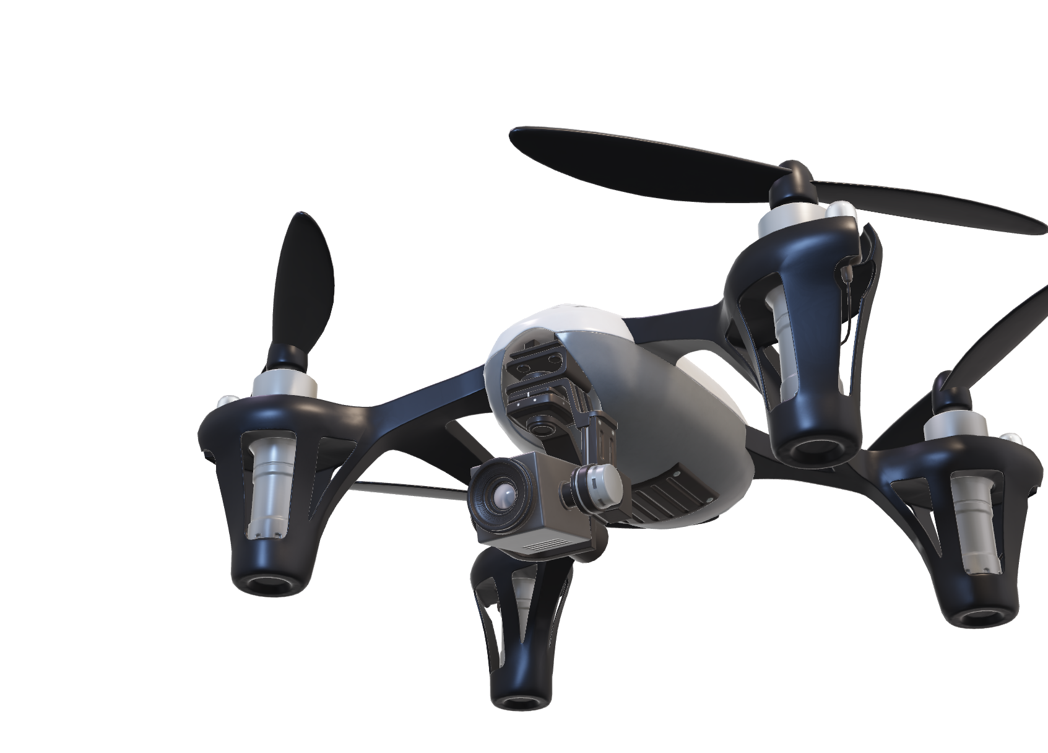
Presentation Overview
Context and Purpose
Requirements
Constraints
Risks
Risk Mitigation
Viability of the Project
Solution Path

Slide 3
Why?

Slide 4
Context & Purpose

Slide 5
What?

Slide 6
Requirements

Slide 7
Constraints

Slide 8
Risks?

Slide 9
Risks
Management
Legacy
Hardware
Software

Slide 10
Risks

Slide 11
Risks Management

Slide 12
Viability

Slide 13
How?

Slide 14
Solution Path

Slide 15
Q?

Slide 16
Q?

